Slide 1
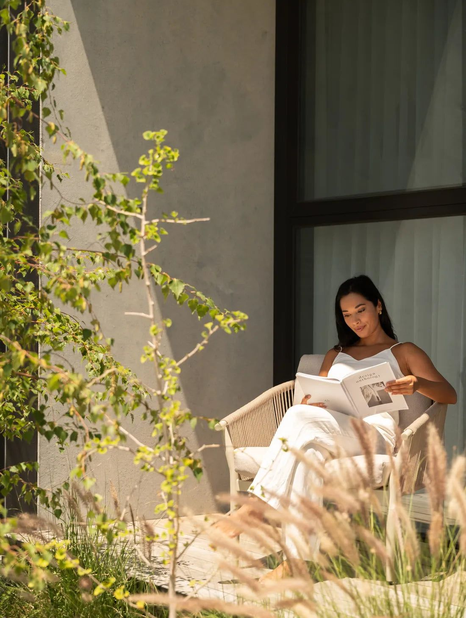
WEEKEND PHOTO DIARY
a weekend
that felt like
a deep breath
sunlight, slow pages, and nowhere urgent to be.
swipe for the little moments →
[CITY] · [MONTH] · [YEAR]

Slide 2
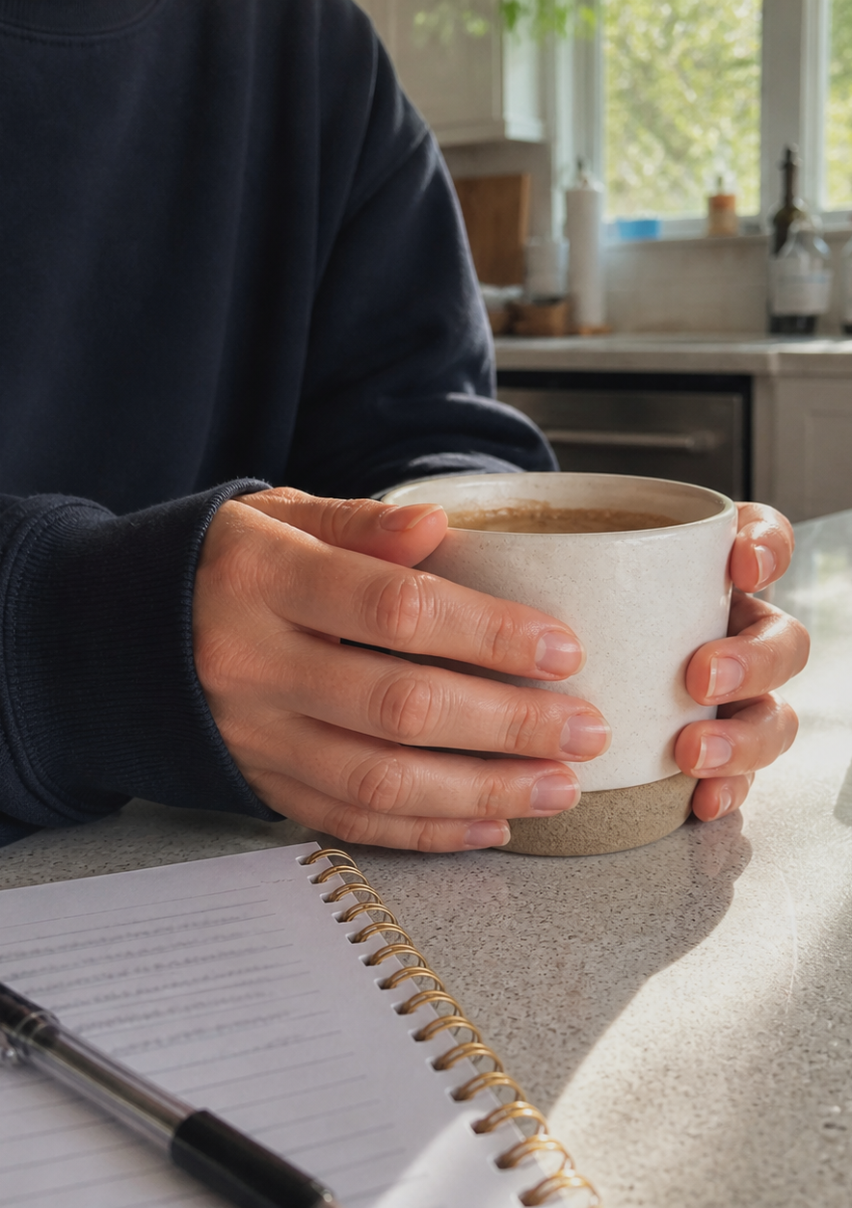
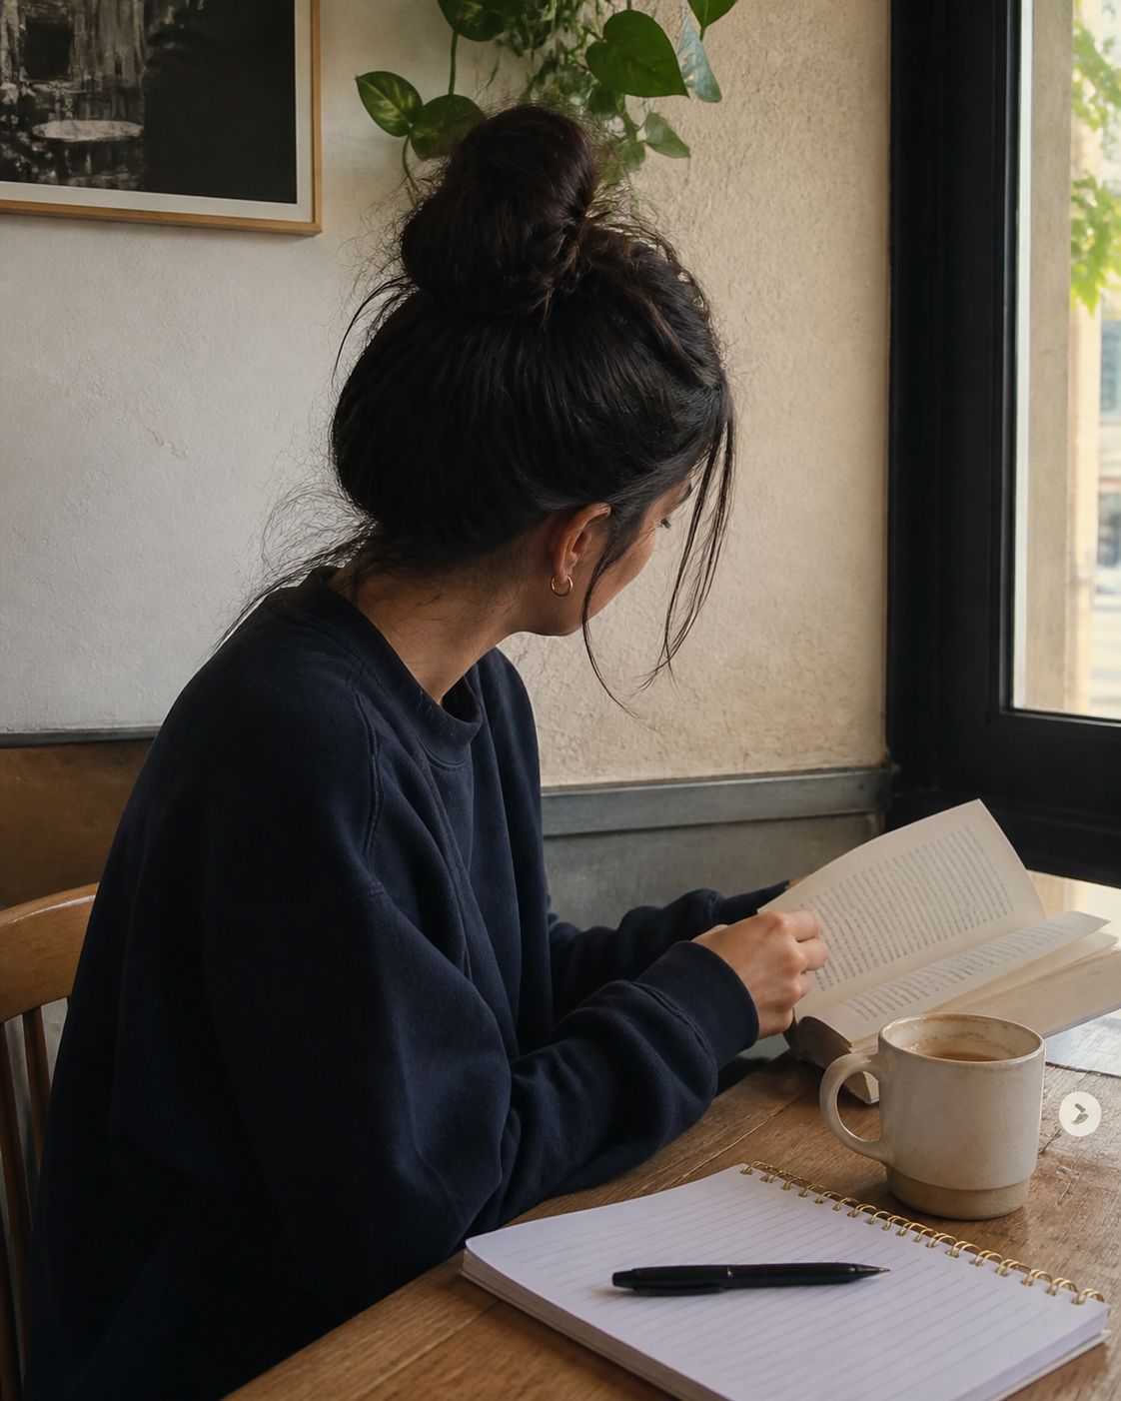
01 · LITTLE MOMENTS
a few things
i want to remember
the kind of moments that make a weekend feel longer in the best way.
A LITTLE NOTE
“more slow mornings, please.”

Slide 3

02 · THE LITTLE THINGS
small favourites
from lately
THIS WEEKEND:
01 [a book / a place / a tiny ritual]
02 [a meal / a moment / a thought]
03 [something i want to do again]
04 [a song on repeat]
SAVE THIS FEELING

Slide 4
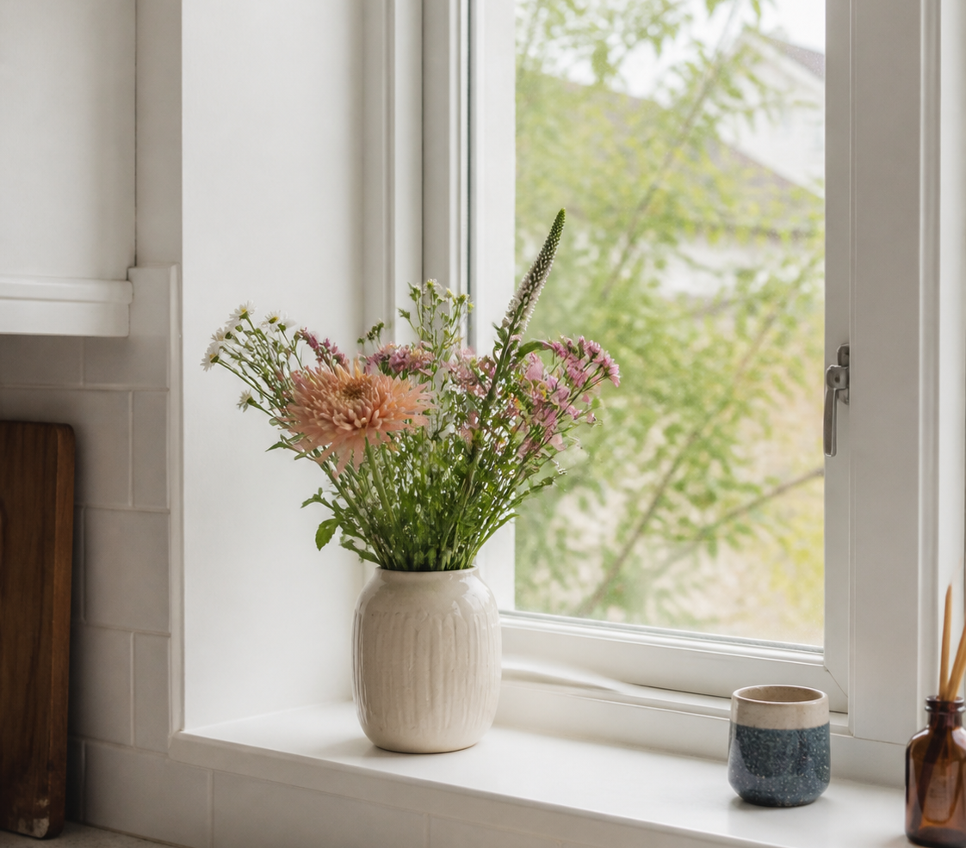
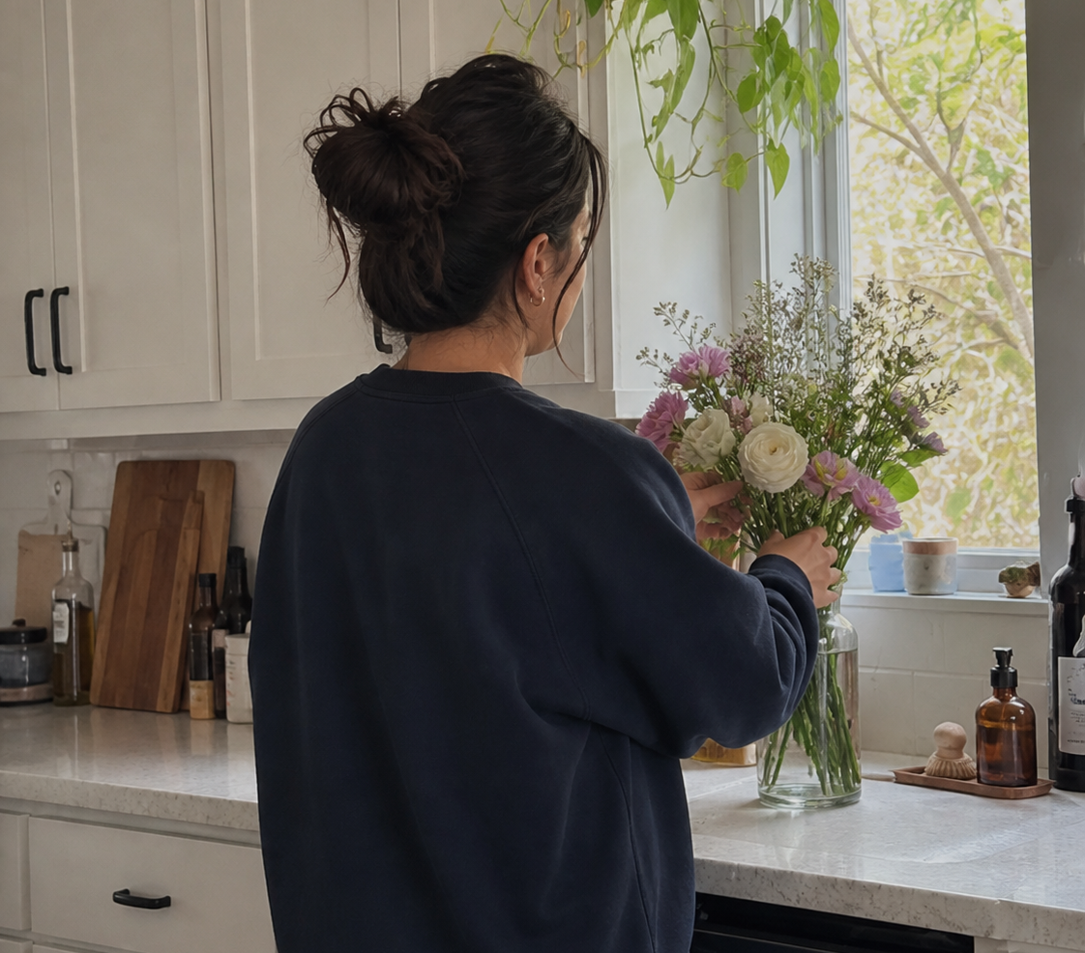
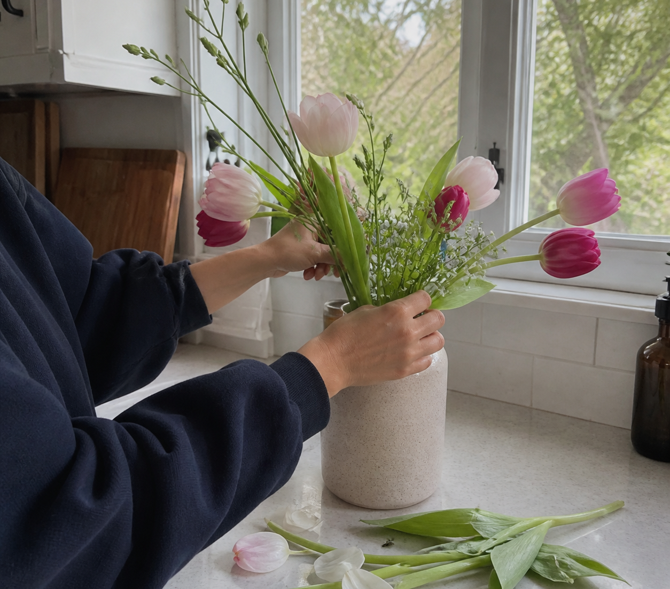
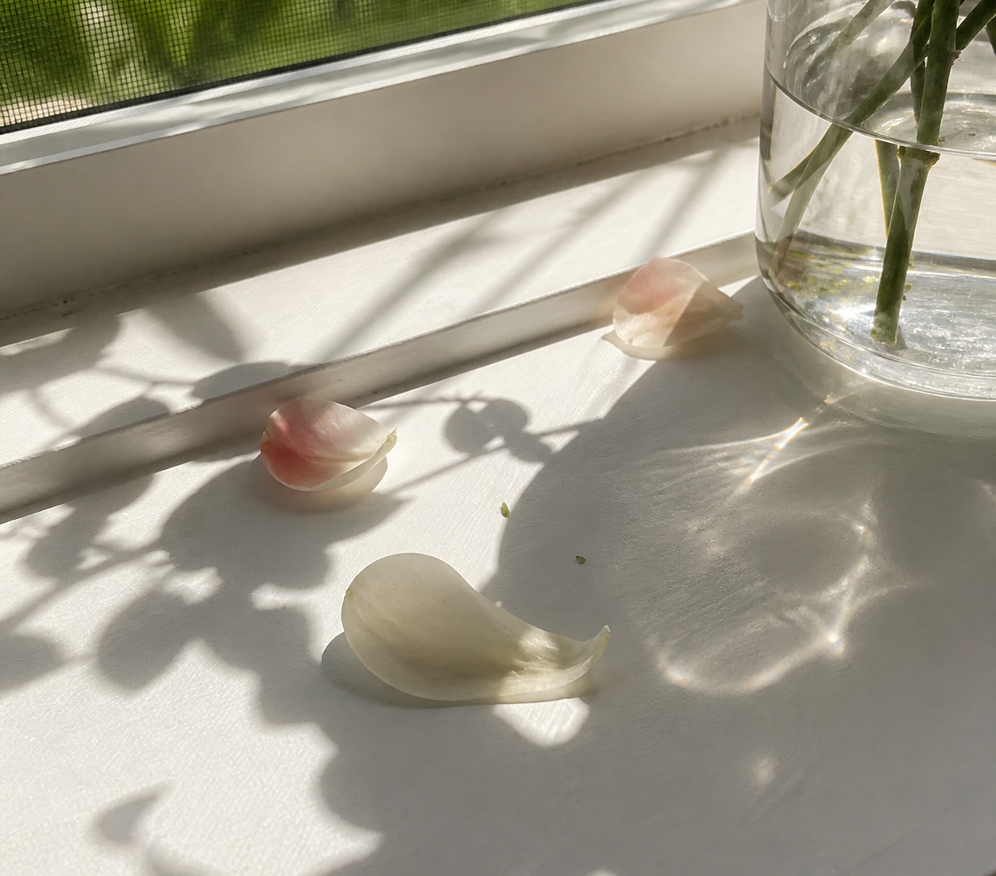
03 · CAMERA ROLL
four frames
from the weekend
[ADD DATE STAMP]

Slide 5
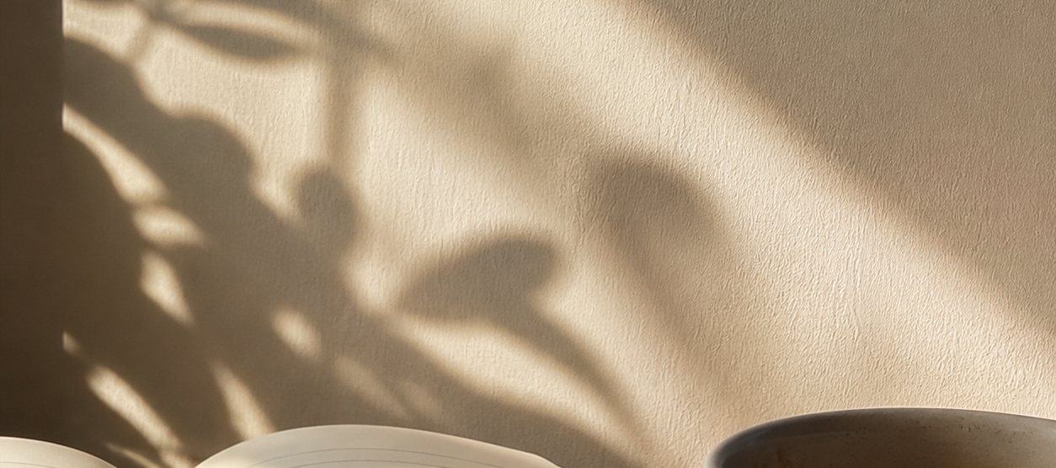
04 · UNTIL NEXT TIME
until the next
little weekend
SAVE FOR LATER
[one closing thought that feels true to you.]
WEEKEND PHOTO DIARY · [YOUR HANDLE]

